Slide 1

a
W E E K O F L E A R N I N G
07.05.20 | M S Ramaiah Institute of Technology
Supported by
Notes:
各会場について、支援組織の日付、大学名、ロゴを編集する必要があります

Slide 2



Agenda
Introductions
What is Week of Learning?
What is Progate ?
Important points for participants!
01
02
03

Slide 3
01
What is
Week of Learning?

Slide 4




Week of Learning
・Learn the most in-demand technologies,
one week at a time!
・In this Week of Learning, we will learn HTML,
CSS and JavaScript to build confidence as a web developer.
01 : What is Week of Learning?

Slide 5
Getting started with
Web Development
01 : What is Week of Learning?
HTML, CSS, and JavaScript are main languages for
web development.
HTML
CSS
JS

Slide 6



Getting started with
Web Development
01 : What is Week of Learning?
These 3 languages are used by many companies.
If you have knowledge of HTML, CSS and JavaScript,
you can build a beautifully decorated and dynamic website.
Notes:
Objective of this slide is to give participants an overview of web development

Slide 7
Week of Learning
Kickstart your Web Development Journey
01 : What is Week of Learning?
DAY 0
SESSION
DAY 1
LEARNING
DAY 7 LEARNING
DAY 8 SESSION
Webathon
(Online Hackathon)
Get ready!
Join a webinar and try your hands on web development by making
a project.
Build your own project and get
a chance to win exciting prizes!
Learn Fundamentals of HTML, CSS & JavaScript on Progate

Slide 8
02
What is Progate ?

Slide 9

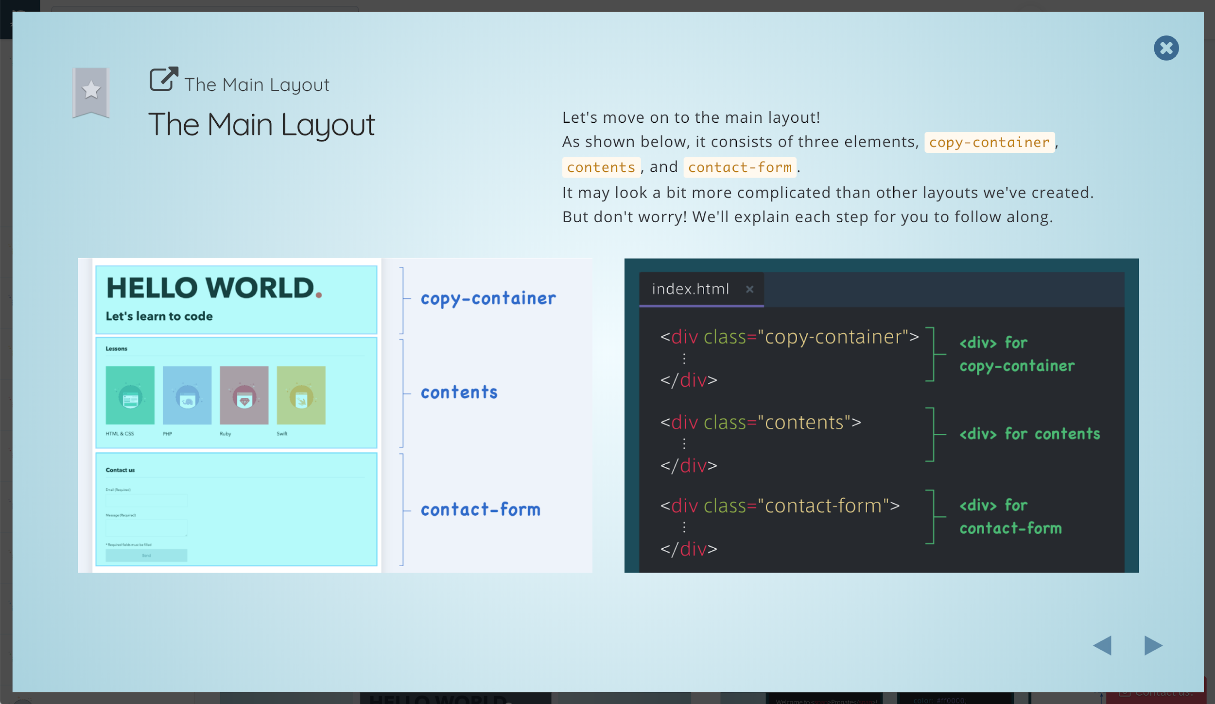

About Progate
Online learning platform from Japan
Built for beginners to learn to code.
Over 1 million learners in 100+ countries.
02 : What is Progate ?

Slide 10

Progate Vision
Empowering everyone to open new doors
through programming.
02 : What is Progate ?

Slide 11
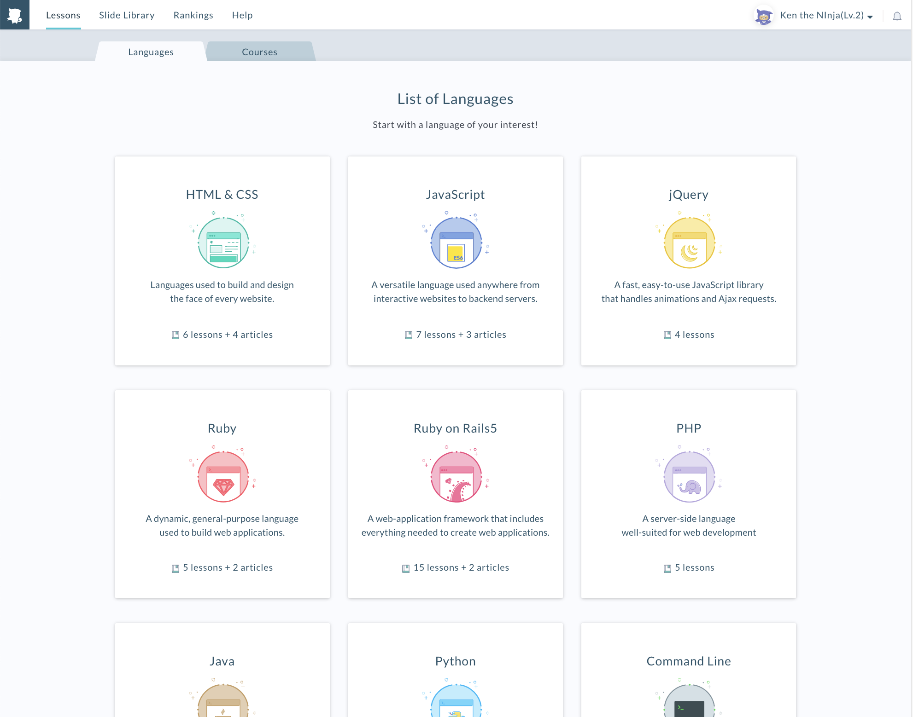
Select language from list
02 : What is Progate ?

Slide 12
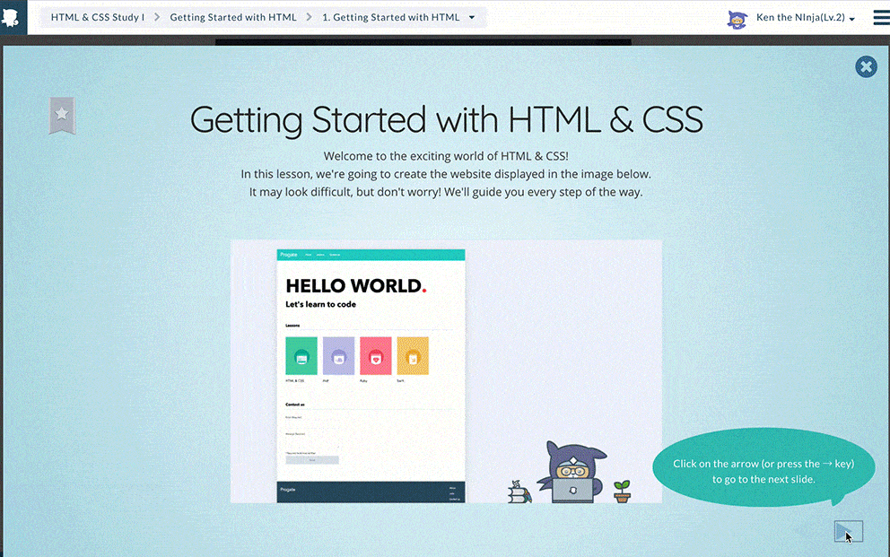
Intuitive slides
02 : What is Progate ?

Slide 13
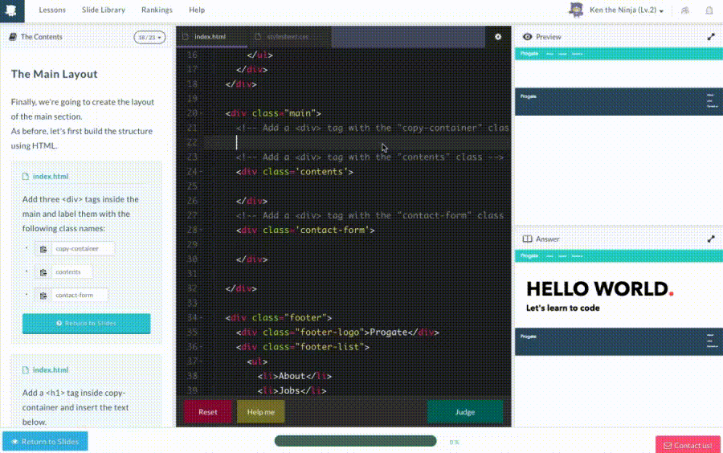
Learn by doing
02 : What is Progate ?

Slide 14
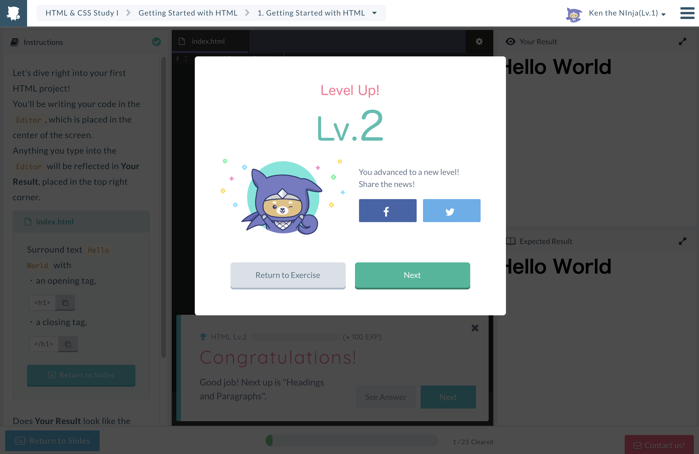
Gamification
02 : What is Progate ?

Slide 15
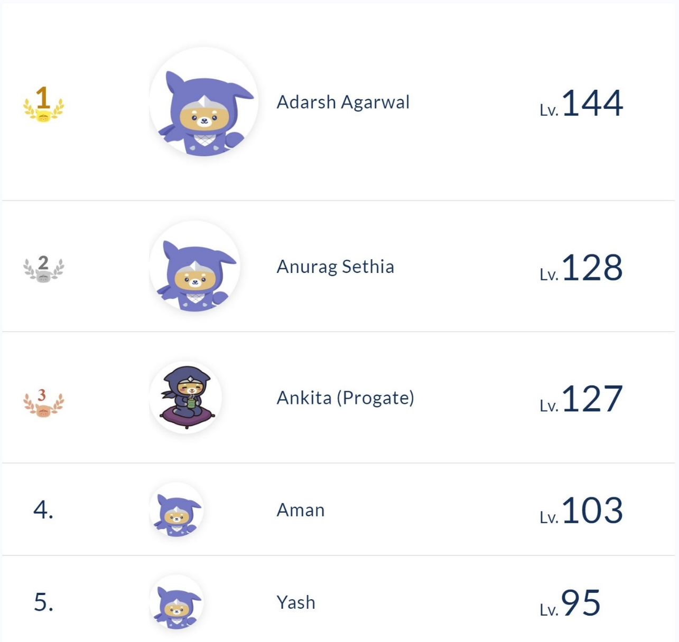
Compete with your friends
02 : What is Progate ?

Slide 16

02 : What is Progate ?
DEMO of Progate
Organizer will show how to use Progate

Slide 17
03
Important points for participants!

Slide 18


Communication tool for
Week of Learning
03 : For participants!
STEP 1
Join WhatsApp group for the Week of Learning at your college!
URL: *************************
STEP 2
Get Updated for the coming information!
J O I N

Slide 19
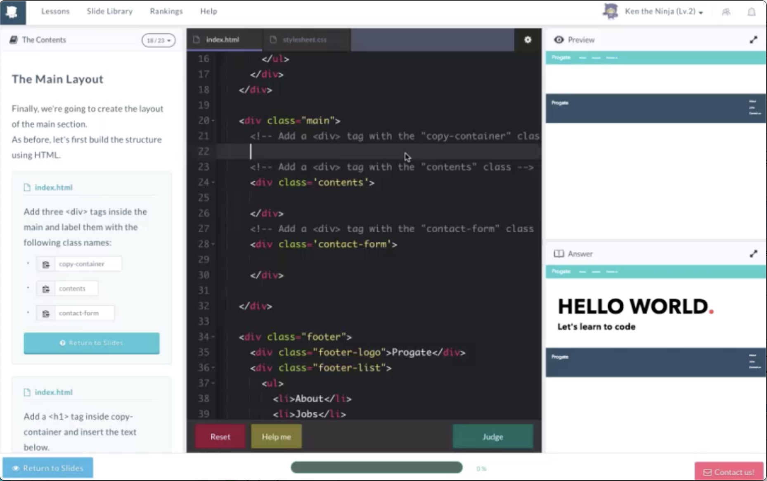
Requirements to join Day 8 Meetup
STEP 1
03 : For participants!
Complete HTML&CSS Lesson I, II and III on Progate
STEP 2
Complete JavaScript (ES6) Lesson I, II and III on Progate

Slide 20


Rule for participants - 1
Complete HTML and CSS lessons before moving to JavaScript!
This will help you understand what’s happening under
the hood as you develop and debug your web apps.
03 : For participants!
HTML&CSS
JS

Slide 21
Rule for participants - 2
Do not learn JavaScript ES5 lessons!
ES6 is the latest version of JavaScript on Progate.
Please complete ES6 lessons only.
03 : For participants!

Slide 22
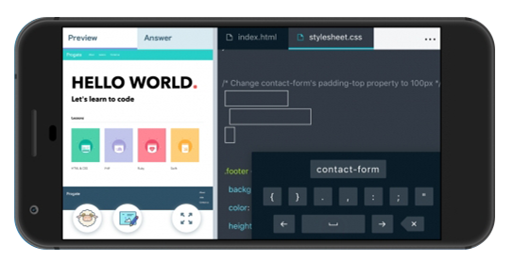
Rule for participants - 3
Please learn on Progate website, not on the app!
（We will check the completion rate of web version）
03 : For participants!

Slide 23
Announcements

Slide 24
Say ‘ Hello World ! ’
All the lessons of HTML & CSS and JavaScript(ES6) are unlocked now!
Announcements
Hello World!
Notes:
Let them know that they can start learning the first lesson of HTML&CSS right away!

Slide 25


Are you ready to learn and
win some cool prizes?
Announcements
1

Slide 26
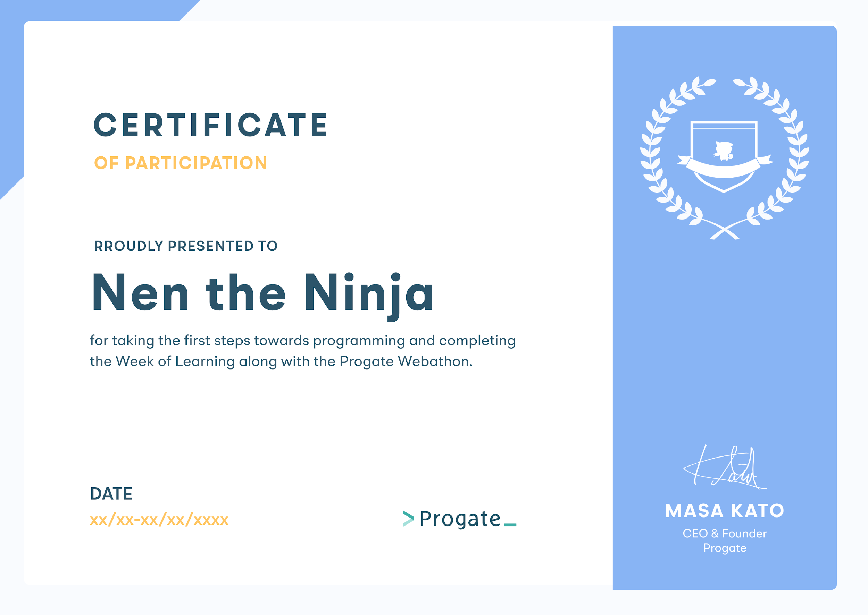
Earn the certificate!
Make your resume stellar by earning a certificate!
All participants who complete the Week of Learning will be awarded certificates. This proves you have great coding skills!
Announcements
Notes:
Make your resume stellar by earning a Progate Week of Learning certificate! All participants who complete the Week of Learning from Day 1 to Day 8 and submit their project in Webathon will be awarded certificates.
This proves you have great coding skills!

Slide 27
Contest Alert!
Get a chance to win Amazon Voucher worth ₹250!
The participants with maximum number of points will win ! To enter the contest, you need to fill out the form below by 8pm on the previous day of Day 8 Meetup.
Announcements
WIN POINTS
ACTION
20
Complete all lessons required for Week of Learning
10
Track your learning progress on LinkedIn with us using #CODE2SUCCESS
each
5
Connect with Progate on Instagram and Linkedin
Submit here: bit.ly/progatesocialmediacontest

Slide 28

Message from the CEO of Progate
https://youtu.be/cN_fSgj6z8k

Slide 29

T H A N K Y O U !

